Slide 1
VR Jerusalem
581-01

Slide 2
Goal: Re-imagining the Past with VR
This project takes a new spin on century old stereograph images, converting images to a virtual reality space. The idea is to give a new life to these images, and tell the story behind the moments captured in a radically different period than our own. The viewer will be presented with a historic photo. The goal is to emerge an audience in a historic time period in a area foreign to many.

Slide 3
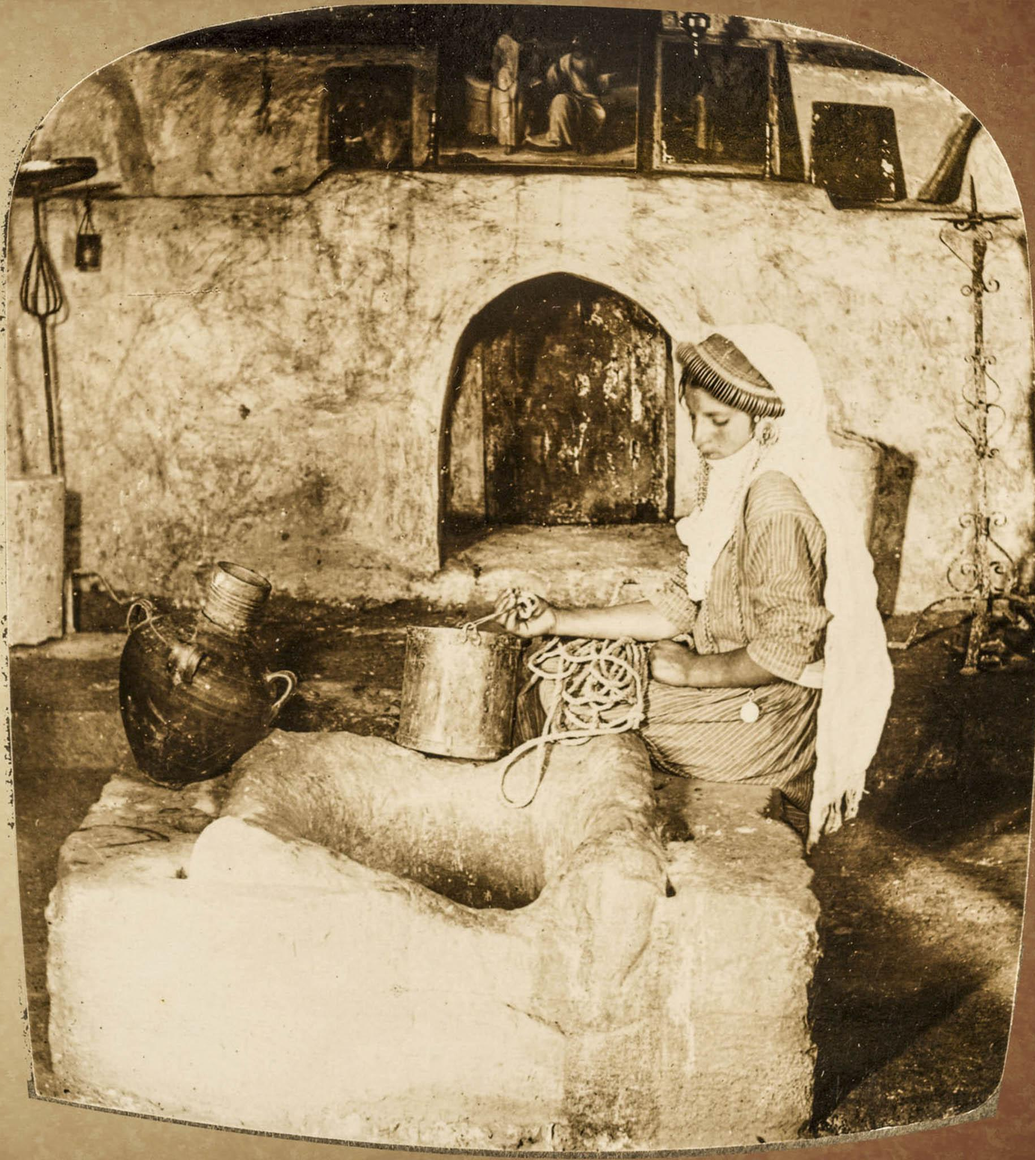
Start to Finish
A Look at Our Progress

Slide 4
The JavaScript Mockup: Jumping off
The first prototype we made for the project was the Javascript build. This was done as a proof of concept. The build is located here.
The goal with this was to show the image in such a way the it could be seen on a phone with a google cardboard. This was accomplished with this build. The final build worked off of the same premise as this one.
After this build was made, the team decided to continue work in Unity because that platform would allow us to do more complicated 3D things in addition to the stereographs, such as 3D video of modern times, or walking around a virtual museum.

Slide 5
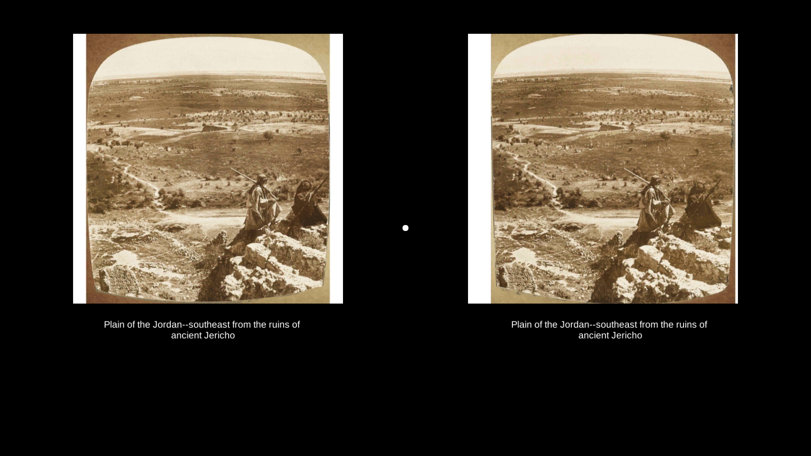
What We Accomplished
We created...
a stereographic 3D experience of Jerusalem in the 1900’s
Could be used in a museum exhibit on a phone using the Google Cardboard.
Complete with subtitles and audio.
The build is located on Github
Screenshot of final build

Slide 6
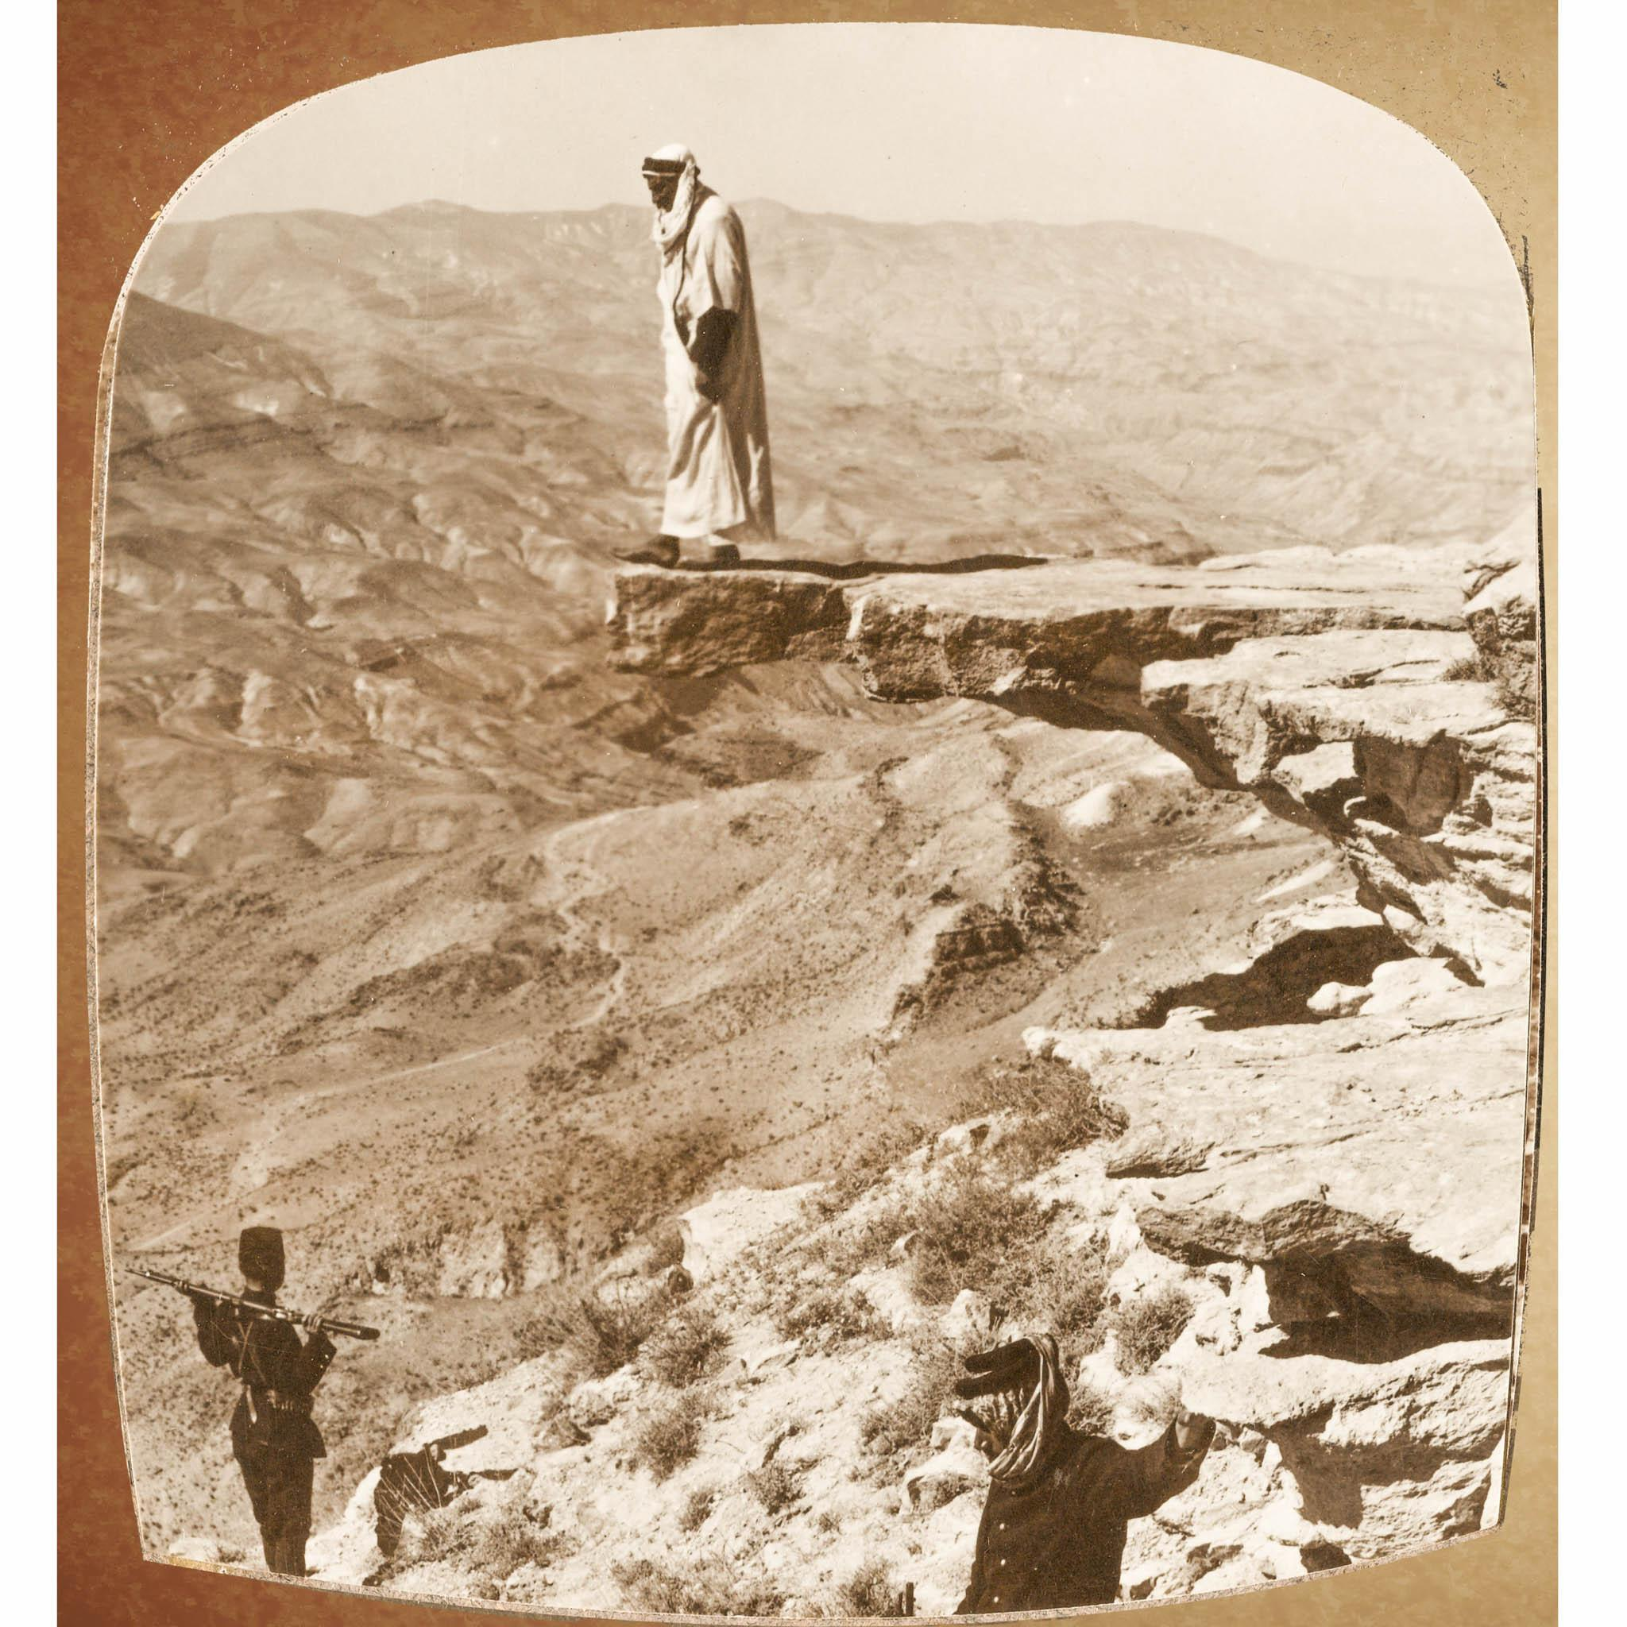
Lessons Learned
Hindsight is 20/20

Slide 7
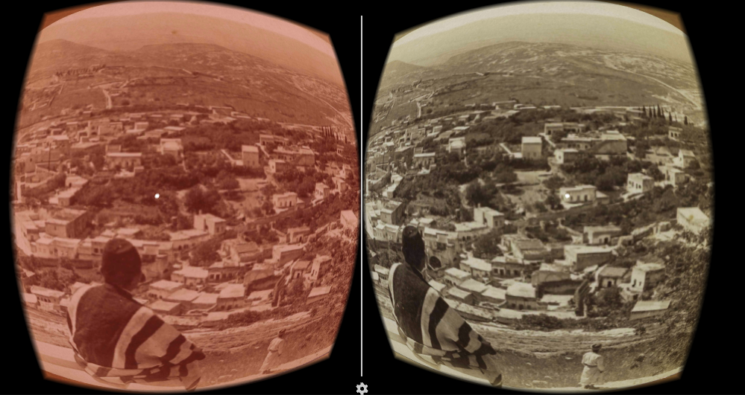
3D Technologies
You cannot merge two different 3D technologies and get a 3D image.
GoogleVR libraries will not allow you to build to android and split the screen as you can see in the editor.
What we tried so hard to do is simply not possible with this technology
Editor view of split screen cameras

Slide 8
What went poorly?
Major delays and issues due to Google VR libraries
UI, Zoom and Pointer all relied on this which meant they repeatedly had to be scrapped and redone
Lots of restarting
Boiled down to issues with the software. What we were trying to do cannot be done. Dependencies also slowed down development.
If we were to do it again?
Use the ‘fake VR’ or stereographic 3D logic that we prototyped in Javascript.

Slide 9
What went well?
Image Processing
Audio Recording
Posters
Parallel Development
This saved us in the end
"Write once, run anywhere" (WORA)
This meant that redoing our work was a lot easier
Screenshot of final build

Slide 10
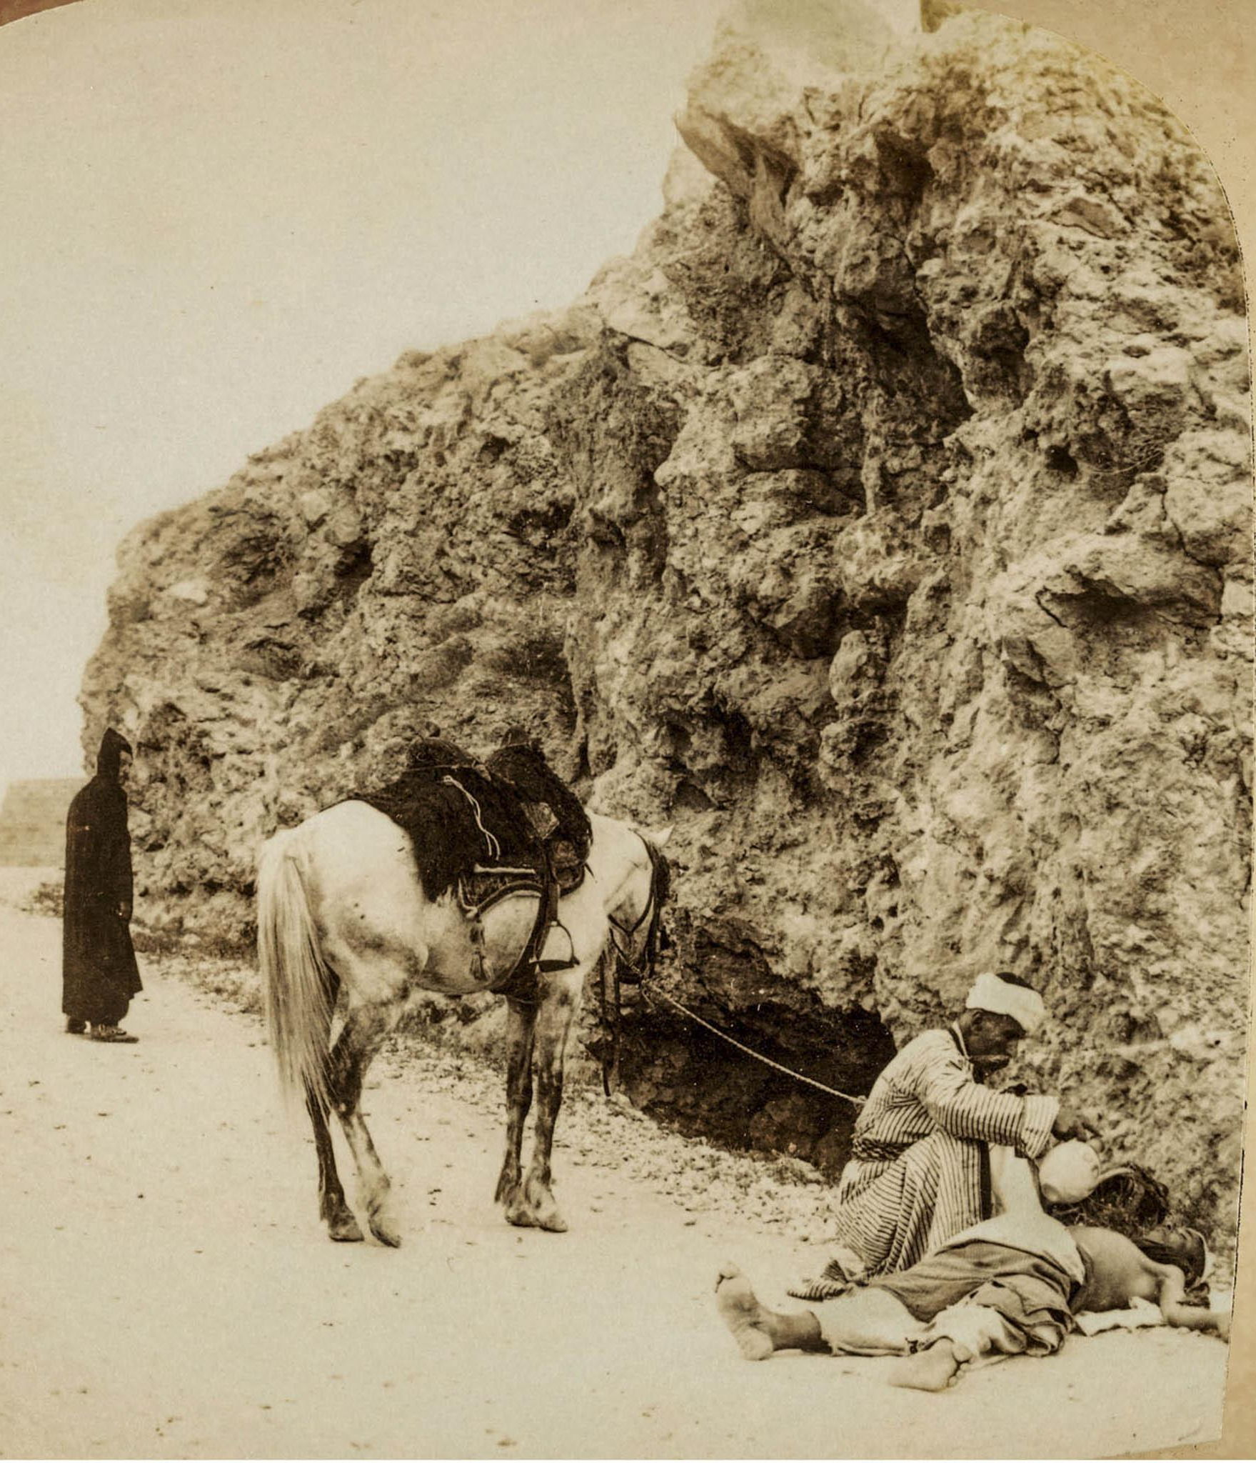
Future Development
Where to go from here?

Slide 11
Future Development
Resources:
Documentation & Powerpoints & Instructables on github
Github organized
Code is commented
Future potential endeavors:
Adding modern content
Changing out the stereographs
This is made easy due to how its coded - See the instructions on Git
Museum environment
... and More!

Slide 12
Thank You!

